Slide 1

Powered By Mohammad Ghadieh

Slide 2
AliExpress is an online store where you can buy a wide range of products at affordable prices.
You can find millions of different products on AliExpress, such as electronics, fashion, home products, camping and hiking products and more.
AliExpress connects buyers directly with sellers, allowing you to buy products in small quantities or at wholesale prices.
You can find both well-known brands and unbranded items on AliExpress, giving you many options to choose from.

Slide 3
When shopping on AliExpress, you have different payment options like credit cards, PayPal, or AliPay, their own payment system.
Shipping options depend on the seller and your location. Some products offer free or low-cost shipping.
AliExpress has a user-friendly website and provides customer support in multiple languages, so you can get help if needed.

Slide 4

AliExpress has a helpful feature: customer reviews and ratings for products, which help you make better decisions when buying.
In my project, I developed a code that predicts recommendations for any item you choose, making it easier for you to find the right products.
By reading customer reviews, looking at ratings, and using my recommendation code, you can shop smarter on AliExpress.

Slide 5
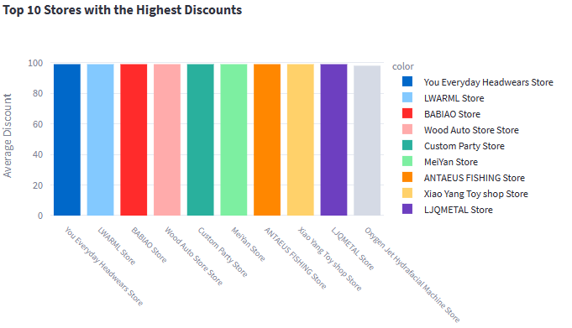

Slide 6
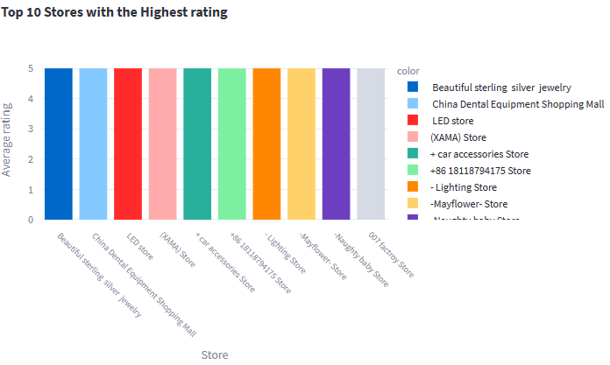

Slide 7
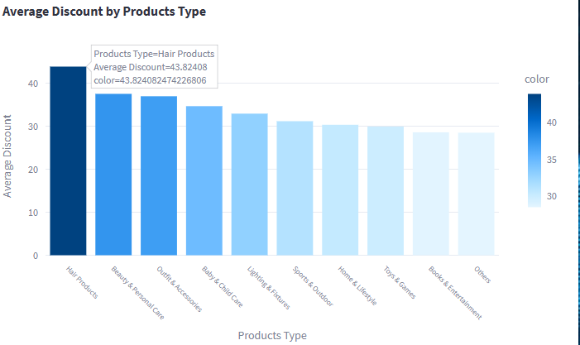

Slide 8
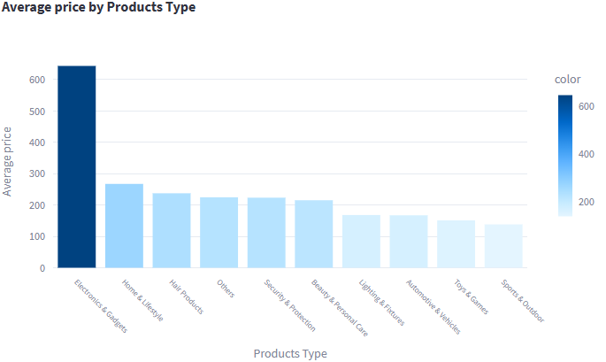

Slide 9
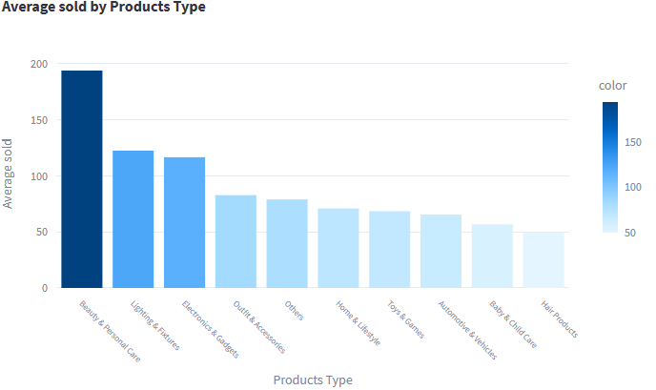

Slide 10
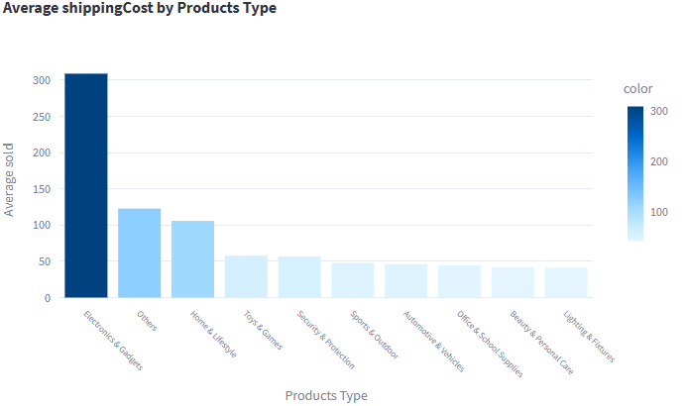

Slide 11
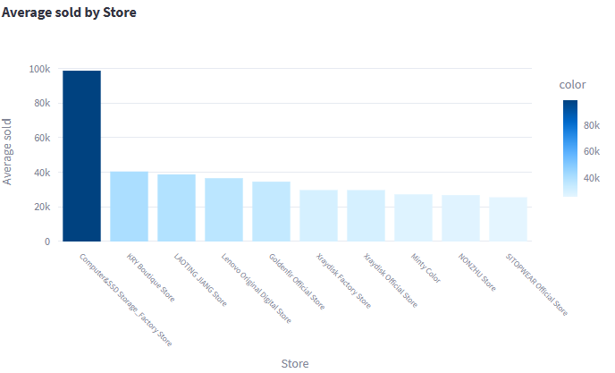

Slide 12
